Slide 1
Hobbies
Ge Ruipeng
Eric
Mar. 5th
Notes:
Hello, everyone. It’s my turn again to introduce one of my hobbies to you. Time is limited. So let’s just get to the point.

Slide 2
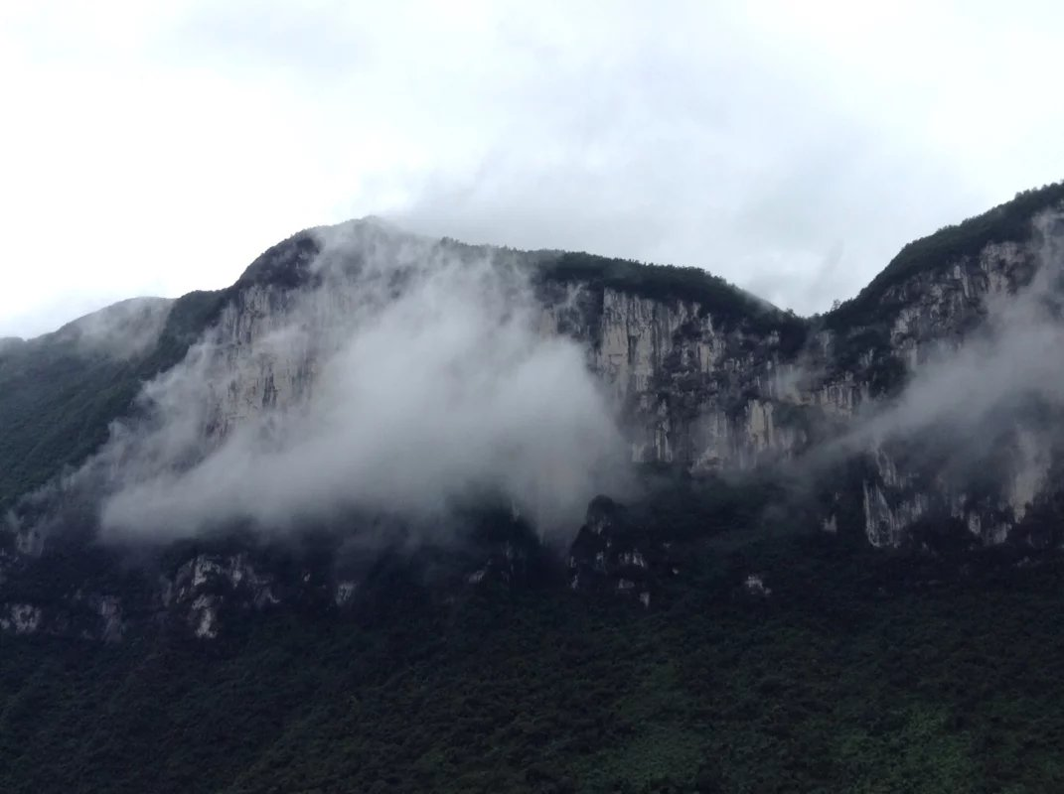
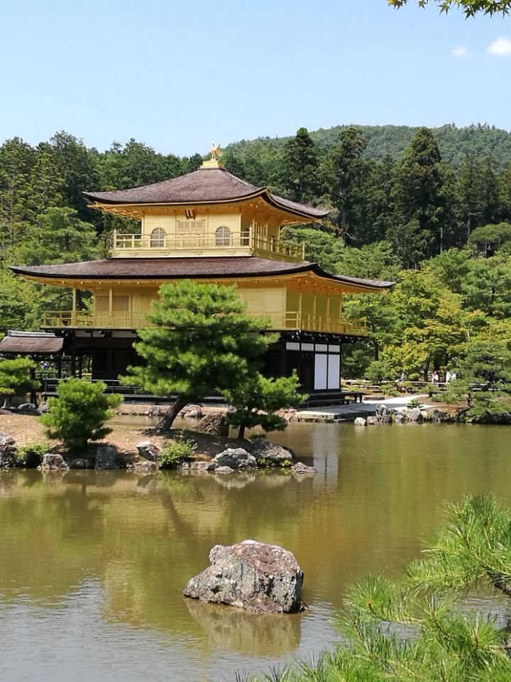
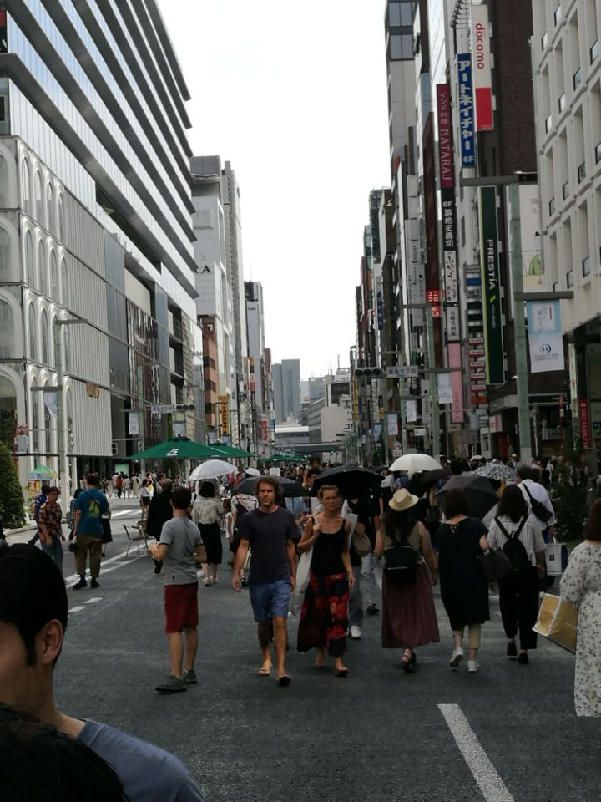
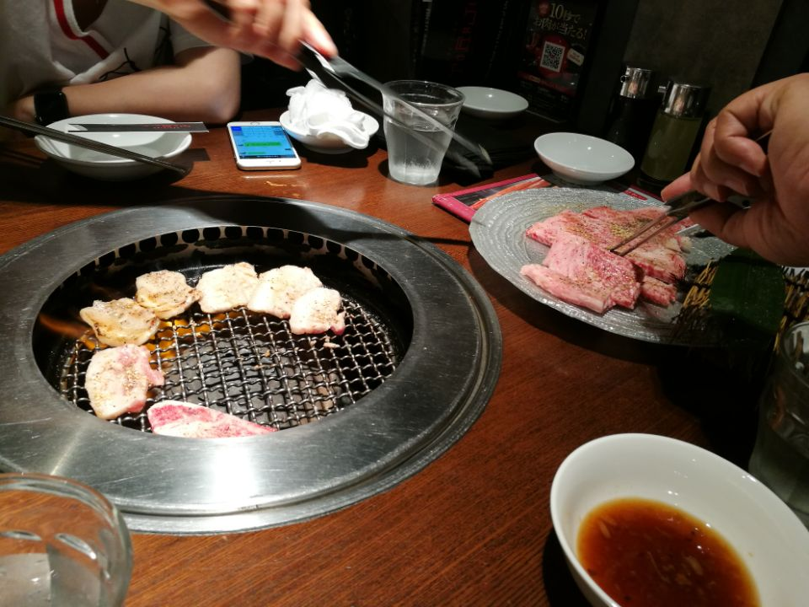
Last semester
—Travelling
Get relaxed mentally
Enrich knowledge
A kind of exercise
Broaden horizon
Notes:
Last semester, I gave a 2min speech on travelling. I described some of the places I’ve ever been to. Actually, I started travelling when I was very young. And I’ve been to many places including nature sceneries, historical sites, as well as modern metropolitan. But this time, let’s get focused on

Slide 3
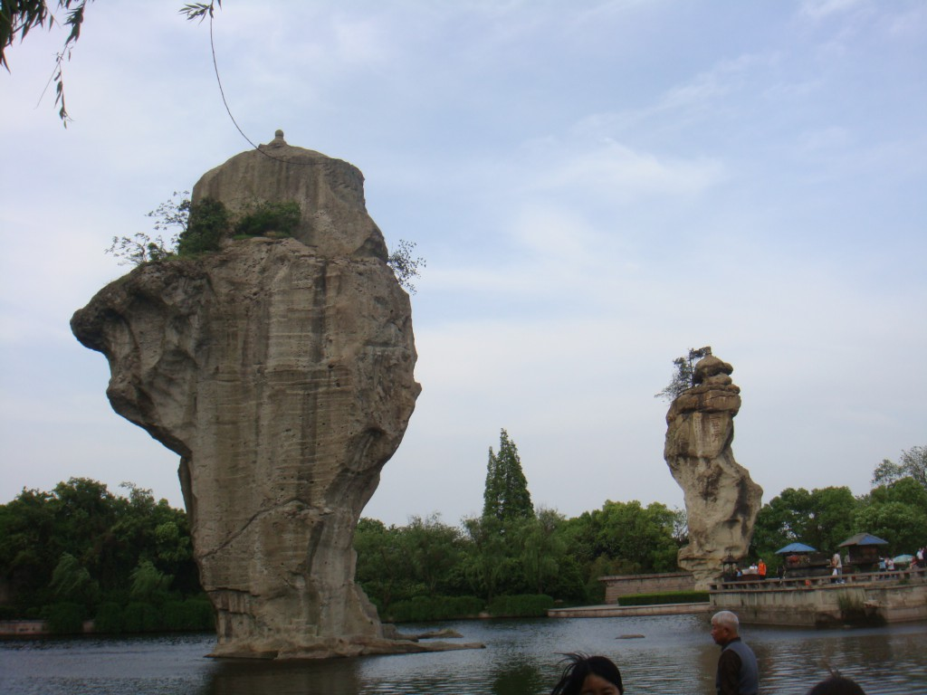
Get focused
—Natural Sceneries
Use your imagination
Spectacular
sceneries
Notes:
Nature Sceneries. Personally, nature sceneries are best places that deserve your visit for various reasons. First, those sceneries are natural-made, not man-made. The Nature itself is just like a professional artist. It surprises you and provides you with relaxed feelings. All the stress and unpleasant memories escape from your mind at that time.
Also, those natural Sceneries can arouse your creativity. You can regard them as whatever you imagine and even come up with legends or stories. Sometimes the tour guide will also introduce the events that had happened here in history, so that you can get the historic meaning and feel its values.

Slide 4
Natural Sceneries
Nature is the art of God．
——Dante
Notes:
Dante once said“Nature is the art of God”. Since we can benefit a lot from the nature, we should try our best to treasure them and to protect them. Using them to relax our minds. And I think this is the true meaning of travelling.

